Slide 1
Welcome
Login
username
UAM
password
Relational Model
Log in

Slide 2




Market Value
48.97
Billion Dollar
18.64
16.64
:-(

Slide 3
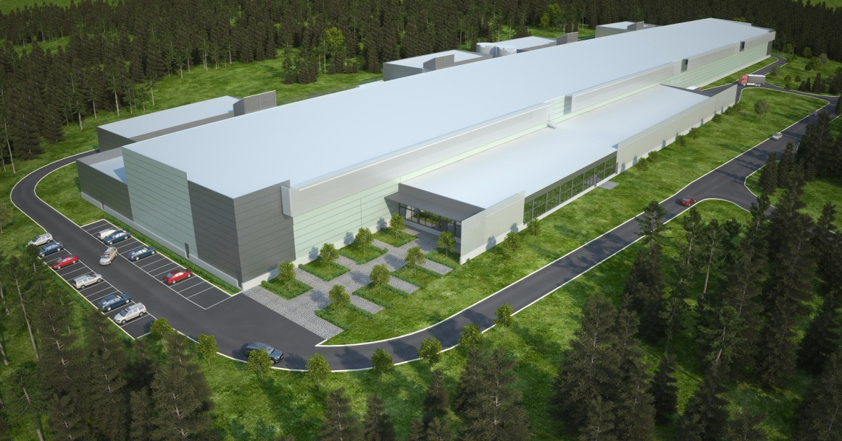

Market Value

Slide 4


Relational Model
Describe
Re-define
Operate
Normalize

Slide 5
Relational Model
Terminology
Describe
Re-define
Operate
Normalize

Slide 6
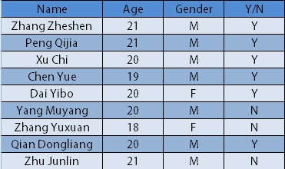
Terminology
Relation

Slide 7
Terminology
Attribute

Slide 8
Terminology
Tuple

Slide 9
Terminology
Domain

Slide 10

Terminology
R (A_{1,} A₂… A_{n})
Schema

Slide 11

Terminology
Degree

Slide 12
Terminology
Superkey

Slide 13
Terminology
Candidate Key

Slide 14
Terminology
Primary Key

Slide 15
Terminology
Primary Attribute

Slide 16
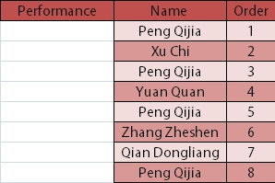
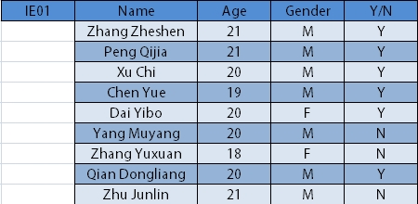
Terminology
Primary Key
Foreign Key

Slide 17
Relational Model
Terminology
Describe
Re-define
Operate
Normalize
Set Theory

Slide 18
Set Theory
Cartesian Product
R(A1,A2,…,An)×R(B1,B2,…,Bm)
= { (A1,B1) , (A1,B2) ,…, (A1,Bm) ,
(A2,B1) , (A2,B2) ,…, (A2,Bm) ,
……
(An,B1) , (An,B2) ,… ,(An,Bm) }
= { (Ai,Bj) | i=1,2,…,n j=1,2,…,m}

Slide 19
Set Theory
A relation is a subset of D1×D2×…×Dn

Slide 20
Relational Model
Terminology
Describe
Re-define
Operate
Normalize
Set Theory
Operation Set

Slide 21
Operation Set
Three Main Components
of Relational Model
Relational Data Structure
Relational Operating Set
Relational Integrity Constraints

Slide 22


Operation Set
Query
Modify

Slide 23
Operation Set
Union
Selection
Projection
Intersection
Difference
Natural Join
Division
Cartesian product
Insertion
Deletion
Update

Slide 24


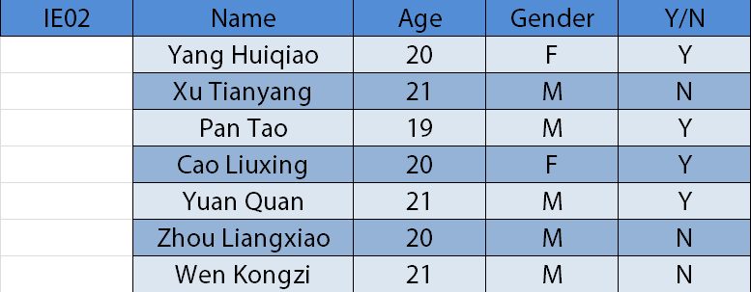
Operation Set
National Day

Slide 25
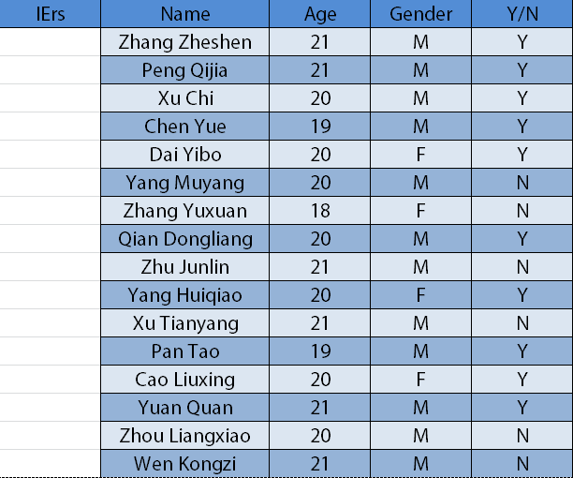
Operation Set
Union

Slide 26
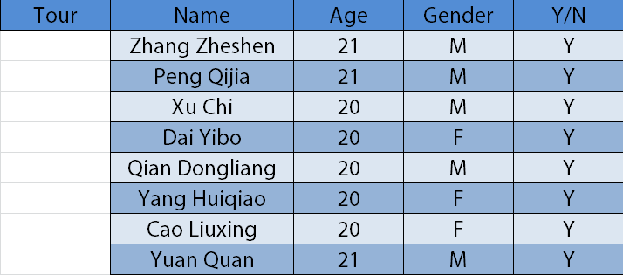
Operation Set
Selection

Slide 27
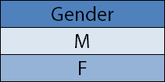
Operation Set
Projection

Slide 28
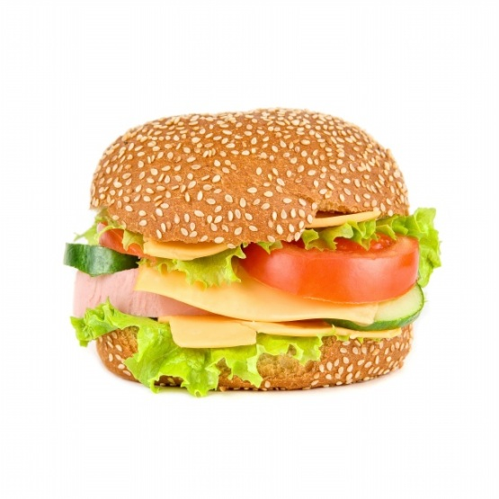

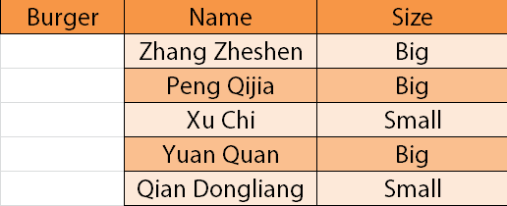
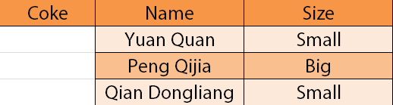
Operation Set

Slide 29
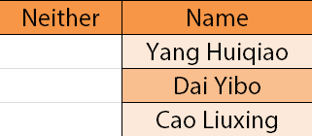
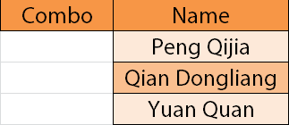
Operation Set
Intersection
Difference

Slide 30
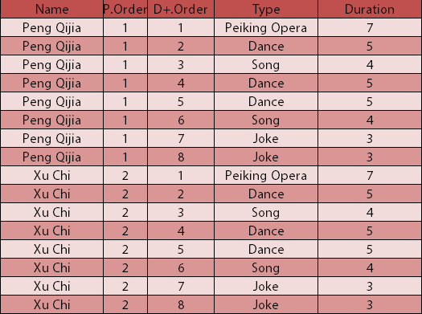

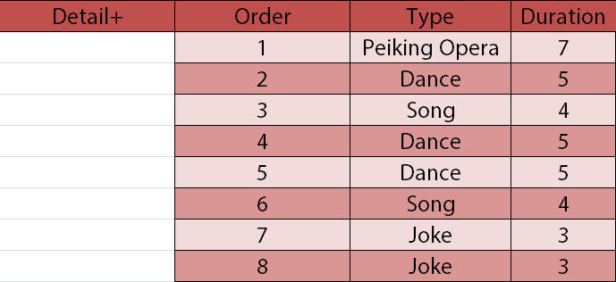

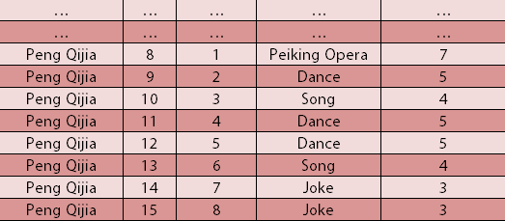
Operation Set
Cartesian product

Slide 31
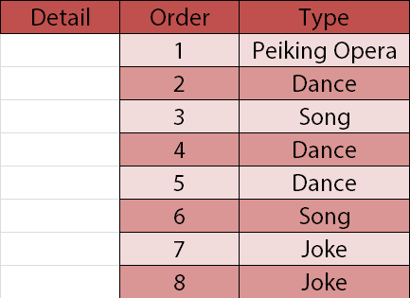
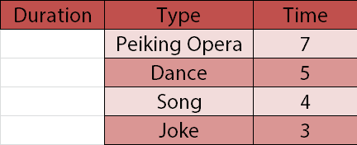
Operation Set
Natural Join

Slide 32
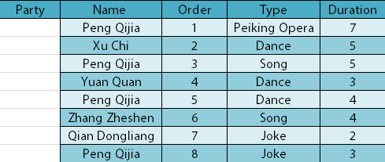
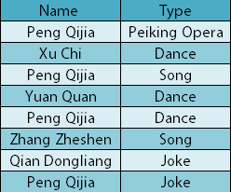
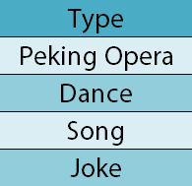
Operation Set
Division

Slide 33
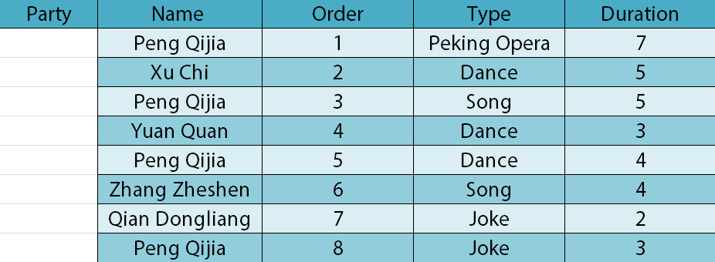
Operation Set
Insertion
Deletion
Update

Slide 34
Operation Set
Domain Integrity
Entity Integrity
Referential Integrity
User Defined Integrity
Domain Integrity
Entity Integrity
Referential Integrity
User Defined Integrity

Slide 35
Relational Model
Terminology
Describe
Re-define
Operate
Normalize
Set Theory
Operation Set
Normal Form

Slide 36
Normal Form
elgg_entity_subtypes
elgg_user_entities
elgg_entities
id | type | subtype
1 | object | file
2 | object | plugin
3 | object | widget
4 | object | blog
5 | object | thewire
6 | object | question
7 | object | answer
8 | object | page_top
9 | object | messages
guid | name
51 | Chen Yue
52 | Xu Chi
56 | Zhang Zheshen
61 | Dai Yibo
65 | Peng Qijia
66 | Yang Huiqiao
69 | Vaina
guid | subtype | owner_guid
80 | 4 | 51
84 | 1 | 52
88 | 4 | 61
90 | 9 | 52
elgg_objects_entity
guid | title | description
80 | My First Blog | <p> This is my first blog </p>
84 | UAM Proposal.docx | <p> UAM Proposal.docx </p>
88 | A Nice Day | <p> I’m feeling good! </p>
90 | Greeting | <p> Nice to meet you! </p>

Slide 37
Normal Form
entity_guid | owner_guid | owner_name | type | subtype | title | description
80 | 51 | Chen Yue | object | blog | My First Blog | <p> This is my first blog </p>
84 | 52 | Xu Chi | object | file | UAM Proposal.docx | <p> UAM Proposal.docx </p>
88 | 61 | Dai Yibo | object | blog | A Nice Day | <p> I’m feeling good! </p>
90 | 52 | Xu Chi | object | messages | Greeting | <p> Nice to meet you! </p>

Slide 38
Normal Form
Problems
Redundancy
Update anomalies
Deletion anomalies
Insertion anomalies
Functional Dependency
Relation R.
Attribute sets X & Y is in R.
X determines Y
Y is dependent on X.
X → Y

Slide 39
Normal Form
owner_guid → owner_name
entity_guid | owner_guid | owner_name | type | subtype | title | description
80 | 51 | Chen Yue | object | blog | My First Blog | <p> This is my first blog </p>
84 | 52 | Xu Chi | object | file | UAM Proposal.docx | <p> UAM Proposal.docx </p>
88 | 61 | Dai Yibo | object | blog | A Nice Day | <p> I’m feeling good! </p>
90 | 52 | Xu Chi | object | messages | Greeting | <p> Nice to meet you! </p>

Slide 40
Normal Form
entity_guid | owner_guid | owner_name | type | subtype | title | description
80 | 51 | Chen Yue | object | blog | My First Blog | <p> This is my first blog </p>
84 | 52 | Xu Chi | object | file | UAM Proposal.docx | <p> UAM Proposal.docx </p>
88 | 61 | Dai Yibo | object | blog | A Nice Day | <p> I’m feeling good! </p>
90 | 52 | Xu Chi | object | messages | Greeting | <p> Nice to meet you! </p>
Partial Functional Dependency
Attribute sets A & B.
A->B.
A subset of A can determine B.
entity_guid | owner_guid | owner_name | type | subtype | title | description
80 | 51 | Chen Yue | object | blog | My First Blog | <p> This is my first blog </p>
84 | 52 | Xu Chi | object | file | UAM Proposal.docx | <p> UAM Proposal.docx </p>
88 | 61 | Dai Yibo | object | blog | A Nice Day | <p> I’m feeling good! </p>
90 | 52 | Xu Chi | object | messages | Greeting | <p> Nice to meet you! </p>
Transitive Functional Dependency
A → B
It is not the case that B → A
B → C

Slide 41
Normal Form
How to evaluate a database?
Normal Form

Slide 42
Normal Form
First normal form (1NF)
Definition：
The domains of all attributes of it are atomic .

Slide 43
Normal Form
Second normal form (2NF)
Definition：
It is in 1NF.
No partial functional dependency.

Slide 44
Normal Form
entity_guid | owner_guid | owner_name | type | subtype | title | description
80 | 51 | Chen Yue | object | blog | My First Blog | <p> This is my first blog </p>
84 | 52 | Xu Chi | object | file | UAM Proposal.docx | <p> UAM Proposal.docx </p>
88 | 61 | Dai Yibo | object | blog | A Nice Day | <p> I’m feeling good! </p>
90 | 52 | Xu Chi | object | messages | Greeting | <p> Nice to meet you! </p>

Slide 45
Normal Form
entity_guid | owner_guid | type | subtype | title | description
80 | 51 | object | blog | My First Blog | <p> This is my first blog </p>
84 | 52 | object | file | UAM Proposal.docx | <p> UAM Proposal.docx </p>
88 | 61 | object | blog | A Nice Day | <p> I’m feeling good! </p>
90 | 52 | object | messages | Greeting | <p> Nice to meet you! </p>
guid | name
51 | Chen Yue
52 | Xu Chi
56 | Zhang Zheshen
61 | Dai Yibo
65 | Peng Qijia
66 | Yang Huiqiao
69 | Vaina

Slide 46
Normal Form
Third normal form (3NF)
Definition：
It is in 2NF.
No transitive functional dependencies between non-key attributes.

Slide 47
Normal Form
entity_guid | owner_guid | type | subtype | title | description
80 | 51 | object | blog | My First Blog | <p> This is my first blog </p>
84 | 52 | object | file | UAM Proposal.docx | <p> UAM Proposal.docx </p>
88 | 61 | object | blog | A Nice Day | <p> I’m feeling good! </p>
90 | 52 | object | messages | Greeting | <p> Nice to meet you! </p>

Slide 48
Normal Form
type | subtype
object | file
object | plugin
object | widget
object | blog
object | thewire
object | question
object | answer
object | page_top
object | messages
entity_guid | owner_guid | subtype | title | description
80 | 51 | blog | My First Blog | <p> This is my first blog </p>
84 | 52 | file | UAM Proposal.docx | <p> UAM Proposal.docx </p>
88 | 61 | blog | A Nice Day | <p> I’m feeling good! </p>
90 | 52 | messages | Greeting | <p> Nice to meet you! </p>

Slide 49
Normal Form
Other normal forms
Boyce-Codd normal form (BCNF)(1974)
Forth normal form (4NF)(1977)
Fifth normal form (5NF) (1979)
Domain/key normal form (DKNF) (1981)
Sixth normal form (6NF) (2002)
5NF ⊆ 4NF ⊆ BCNF ⊆ 3NF ⊆ 2NF ⊆ 1NF

Slide 50
Normal Form
elgg_entity_subtypes
In elgg
Created by us
id | type | subtype
1 | object | file
2 | object | plugin
3 | object | widget
4 | object | blog
5 | object | thewire
6 | object | question
7 | object | answer
8 | object | page_top
9 | object | messages
type | subtype
object | file
object | plugin
object | widget
object | blog
object | thewire
object | question
object | answer
object | page_top
object | messages
Not in 3NF

Slide 51
Reference
Papers and books and Wikipedia here

Slide 52
Acknowledgement
Dr. Benjamin Koo
Yang Liqian
Liu Yifan
Pan Tao

Slide 53
Relational Model
Thank you

